Slide 1
OOP Project Presentation
Submitted To
Sabina Zaman
Lecturer
Department of CSE
Submitted By
The Three Stooges
Level 2,Term I
Tania Sultana
1109003
Jannatual Nuri
1109006
Nahid Hasan
1109020
Bangladesh Army International University of Science & Technology, Cantonment, Comilla

Slide 2
Introduction
Project Name: University Management System
Topics we covered:
Constructor & Destructor
Inheritance
Function Overloading
Friend Function
Inline Function
this pointer
Chaining calls
Operator Overloading
Exception Handling
terminate() and unexpected()
Constant Object
Mutable
Access Specifier
Scope Resolution
Static

Slide 3
Inheritance
University
Student
Faculty
Courses
Result

Slide 4
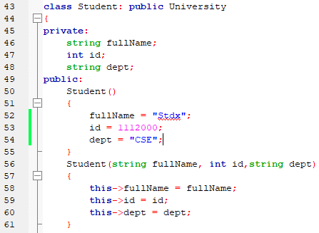
Constructor & Function Overloading

Slide 5
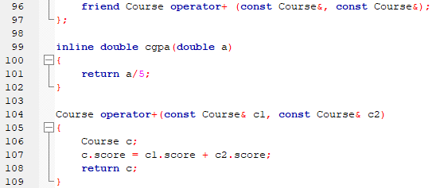
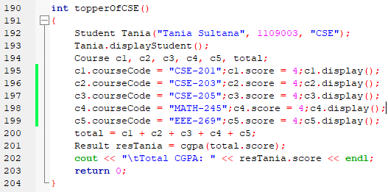
Operator overloading & friend function
Operator overloading with friend
function which works with two objects
at a time.
The CGPA of multiple subjects
are added.

Slide 6
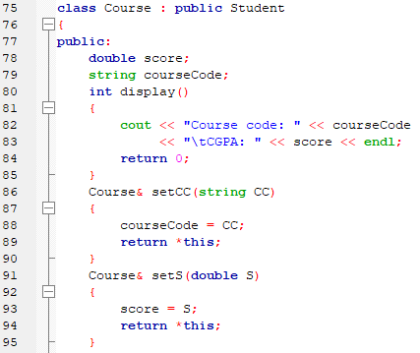
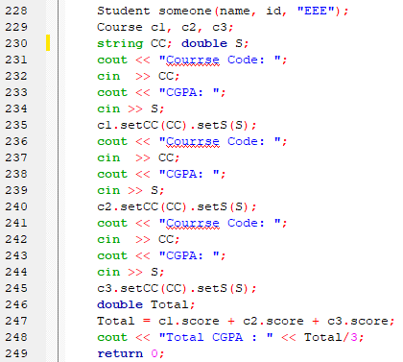
this pointer & Chaining calls

Slide 7
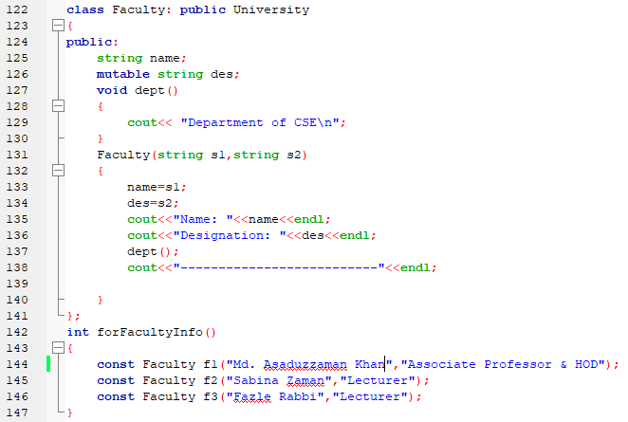
Use Constant & mutable
Newly added faculty members
(objects) will be constant but
there designation is changeable.

Slide 8
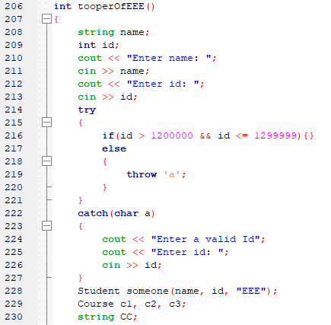
Exception Handling
Here try block checks if the roll number of the
EEE dept. student is valid or not .

Slide 9
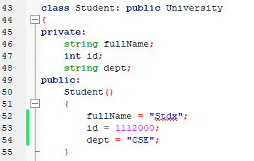
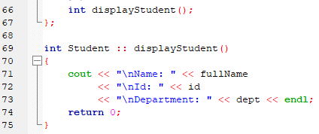

Access Specifier, Scope resolution, Static

Slide 10
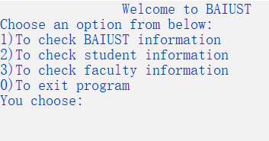
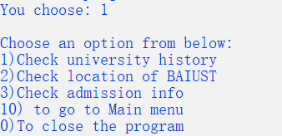
Step-1: After running the program user will get these options
Step-2: Suppose user entered 1 then user will get these options
If user enter 10, user will go back to main menu & if user enter 0, program will end

Slide 11
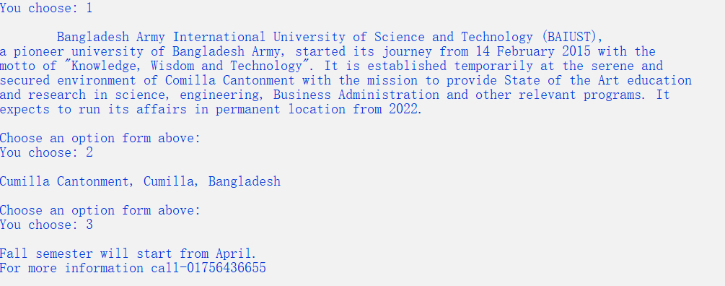
Step-3: Based on user selected option user will get this output
If user enter 10, user will go back to main menu & if user enter 0, program will end

Slide 12
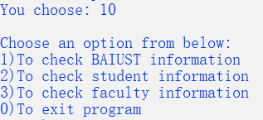
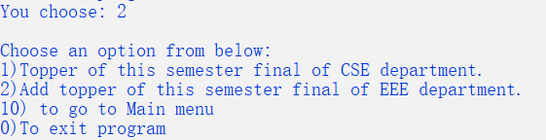
Step-4: Now if user enter 10 user will get back to main menu
Step-5: Now if user enter 2 then user will get this option
If user enter 10, user will go back to main menu & if user enter 0, program will end

Slide 13
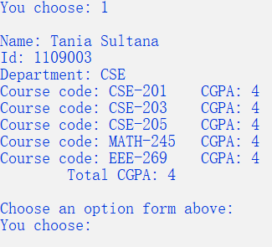

Step-6:If user select option 1 then user will get this output
If user choose option 2 then user will this get option
Here user need to enter name, Id, course code and CGPA of that course, then total CGPA will be counted.
If user enter 10, user will go back to main menu & if user enter 0, program will end

Slide 14
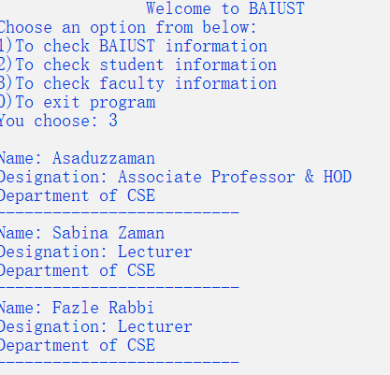
Step-7:From main menu if user choose option 3 then user will get this ouput
If user enter 10, user will go back to main menu & if user enter 0, program will end

Slide 15
Thank You
…if you have any questions you can ask.
The End

